Slide 1
The Captchacker Project http://code.google.com/p/captchacker
Jean-Baptiste Fiot & Rémi Paucher

Slide 2
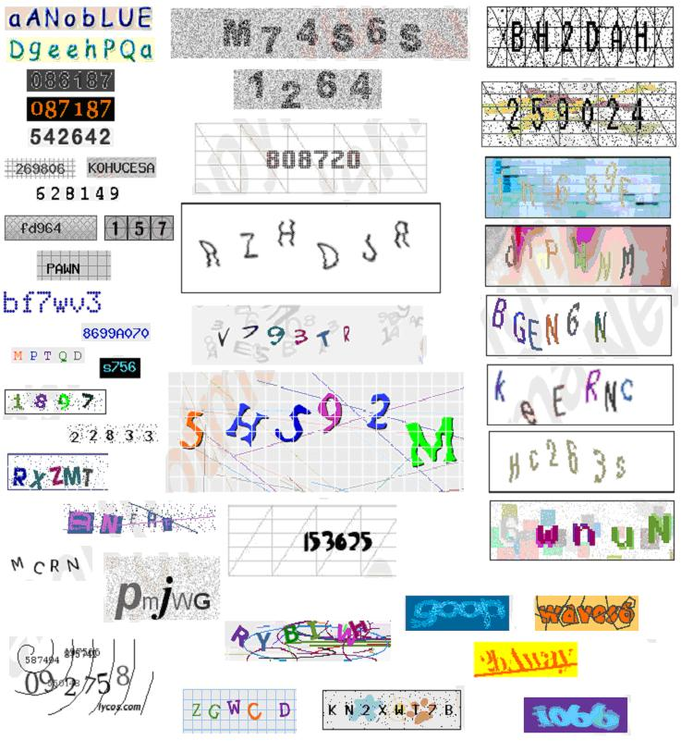
You said captcha???
C.A.P.T.C.H.A = Completely Automated
Program To
Tell
Computers and Humans
Apart

Slide 3
Motivations
Do automatically these delightful activities:
Spam via email address creation
Spam comment on blogs
Website registration
Bias online polls
Brute force attack your sista or gf's MSN account

Slide 4
State of the Art
Geometric Detections
Neural networks
Convolutional Neural Networks (Y. LeCun)
Deep Belief Networks (G. E. Hinton)
Support Vector Machine

Slide 5
Our study
SVM's potential to break captchas
Easily segmentable captchas
Non-easily segmentable captchas

Slide 6
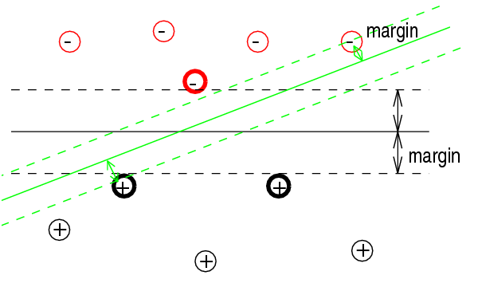
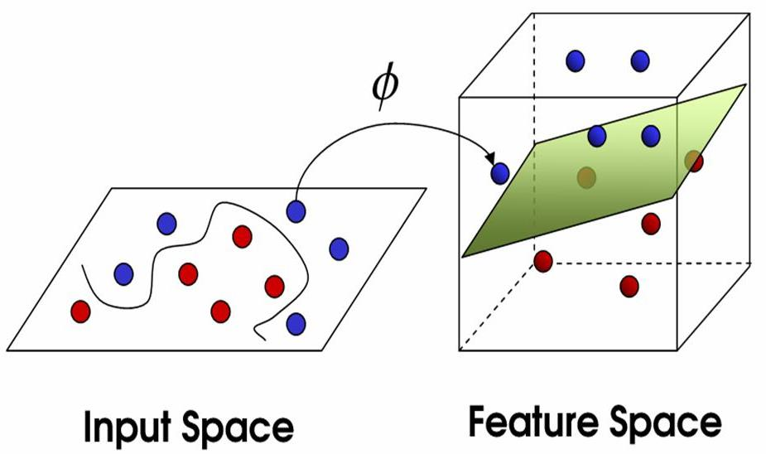
A word on SVM 1/2
Separate data via a hyperplane maximizing the margin
When the data are not linearly separable
Higher dimension space AND/OR
Allow outliers

Slide 7
A word on SVM 2/2
Choosing the error cost C
C too low => many outliers
C too high => overfitting
Demo

Slide 8
Easily segmentable captchas
Captchas from Egoshare.com
Using home-made C++ prog based on OpenCV
Convert to gray-scale
Threshold intensities
Largest connected components (using best result using 4/8 connexity)

Slide 9
How to learn features?
« Font based » or « simulation based » method
« Captcha based » method

Slide 10

« Simulation-based » method
Font files
...................
...................
SVM Model

Slide 11
« Captcha based » method 1/2
Initial Labelled Captcha Set (manually or using font-based models)
… … …
Preprocessed digits
Temporary SVM Model

Slide 12
« Captcha based » method 2/2
Automatically Labelled Captchas (using last computed model)
Enlarged Training Set (wrongly labelled captchas are manually corrected)
Improved SVM Model
Satisfying results ?
NO
YES
Final SVM Model

Slide 13
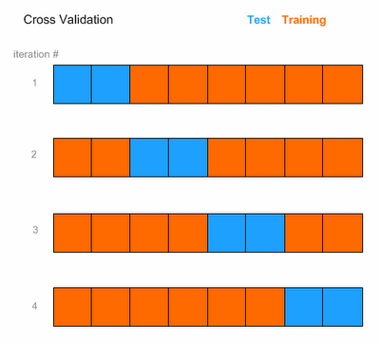
How to choose SVM Parameters?
Kernels
Radius-Based Function (RBF)
Polynomial kernel
Linear kernel
Sigmoid kernel
Outlier penalization (error cost C)
K-fold cross-validation

Slide 14
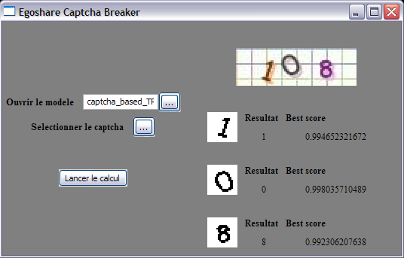
So u hack 'hem all or what???
Check this demo out!

Slide 15
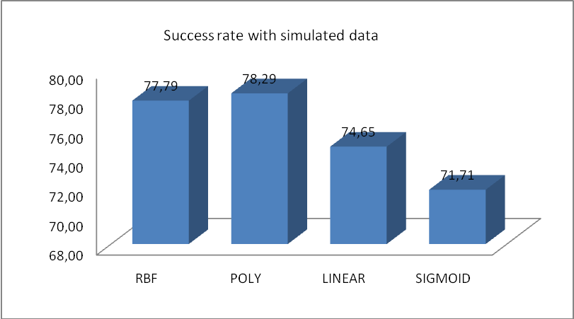
Performance 1/4
Simulation based method:

Slide 16
Performance 2/4

Slide 17
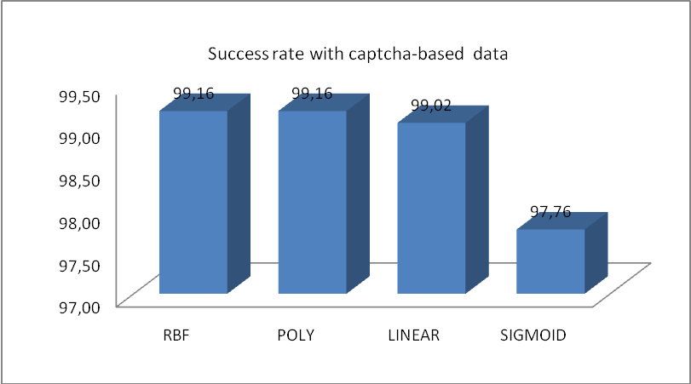
Performance 3/4
Captcha-based method:

Slide 18
Performance 4/4

Slide 19
Other easily segmentable captchas
Nice results with a specific model
Portable method :)

Slide 20
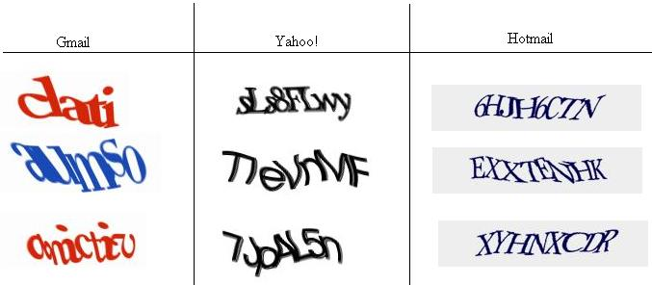
Non-easily segmentable captchas

Slide 21
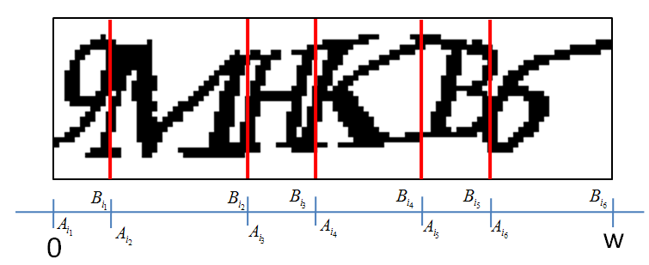
Automatic segmentation
We would like our algo to detect this:

Slide 22

What we’ve got…
Preprocessed captcha
Classifier
Prediction on a subwindow of any width
Score telling how sure the prediction is
0
w
Good score
Medium score
Low score
i₄
i₇
i₁₂
i₈
i₁₃
i₁
i₉
i₃
i₁₁
i₂
i₆
i₁₀
i₁₄
i₅

Slide 23
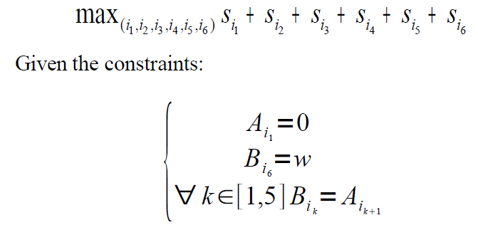
Formalization
Optimization of sum (or product) of scores over all letters:

Slide 24
Resolution
Dynamic programming
For each abscissa
Store the best paths of length 1-6 to go from 0 to the point
For each new segment [A_{i}, B_{i}]
Consider the concatenation of this segment with the optimal paths from 0 to A_{i}
The best path is the best 6-long path at point w !
Very fast (O(n.log(n)) complexity)

Slide 25
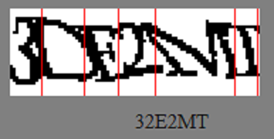
Results
Not so good ☹
Very difficult to build a good model with many classes (high score ⬄ clear character)
Model has to be built with similar data than in the captchas
Some characters are not well recognized
Slow (score computation on each subwindow)

Slide 26
Conclusion
Fun project, with nice applications
Special thanks to Iasonas Kokkinos
http://code.google.com/p/captchacker

